Slide 1
Welcome to
Living Independently
Mrs. Howard
bhoward@cbsd.org
267-893-3000 ext. 6140 (V)

Slide 2
Policies:
Lateness: be in the door by the ring of the bell.
  Late is anything after
  3 lates = conduct referral/detention
Absence: if you are absent, you would turn in an assignment on the day you return. If you have been out for a few days, arrangements will be made by the teacher – UNLESS it’s unexcused.
  Get an excuse note to the office within 3 days

Slide 3
Policies:
Late assignment: Turn assignments in on due date.
  Late assignments will only be accepted for 5 days, each day the grade will drop 10%, max 50%
  After that, it’s a ZERO
Bathroom: Not during instruction.
  Sign out on the board – be sure to sign back in
  Write your pass, I have to sign it

Slide 4
Policies:
Academic Integrity: Academic integrity means avoiding cheating and plagiarism in all forms and taking responsibility and ownership of your own work.
    Make sure your paper/screen cannot be seen by anyone else.
    Keep your eyes on your own paper/screen.
    Do not talk, text, or otherwise communicate with other students.
    Do not use unauthorized notes, resources, computer print-outs, or other information sources.

Slide 5
Policies:
Trips: Students must:
    Be dressed appropriately
    Speak appropriately – the residents may use swear words – you MAY NOT!!
    Take your packet so you know what the assignment is
    Turn in your assignment the next day
    Participate with the residents
    Leave your cell phone and purse in the classroom – it will be locked

Slide 6
Fire Drill/Evacuation to the stadium
Fire Drill: TURN OFF all stoves, ovens and appliances. Take pans off stove.
  Proceed to the parking lot, STAY TOGETHER
  Be sure you are accounted for by the teacher
Evacuation: TURN OFF all stoves, ovens and appliances. Take pans off stove.
  Proceed to the stadium
  Go to your Titan Forum spot and stay there

Slide 7
Lock Down/Severe Weather:
Lock Down:
  Crouch down on the floor in the corner by the printer and sit close together
  BE QUIET!!!
  IF YOU ARE OUT OF OUR ROOM – get to the nearest classroom and stay with them. Once doors are closed/locked, no one but law enforcement/administration gets in/out.
Severe Weather:
  TURN OFF all stoves, ovens and appliances. Take pans off stove.
  Proceed to the hallway
  Sit against the wall with your knees tucked up
  BE QUIET

Slide 8
Tests:
  Ask for help BEFORE the test
  Done on Quia
  Work ALONE
  If you are the first one to find a mistake – you get a bonus point
  Refer to Integrity Policy

Slide 9
Mrs. Howard’s website
  From South’s homepage, go to teacher websites, click on mine.
  Click on Living Independently
  All units are there with all PPTs to review
  This is where you go to print out the HW assignments from the field trips AND reprint anything you lose

Slide 10
Course Packet
Class Packet:
  Have every day
  Show teacher completed work for participation points
  This IS the study guide for all tests

Slide 11
Living Independently
Human Development
A course for life…

Slide 12
Living Independently
Topics of Study:
Relationships
Communication
Consumer Issues
Healthy Food Cooking labs
Conflict Resolution
Adult Development
Partnership with Senior Care Facility
Car Maintenance

Slide 13


Relationships
Voluntary vs. Involuntary
Relationship qualities
Social Exchange theory
Role expectation
Exploitation
Personality traits

Slide 14
Communication
There are 4 BASIC ELEMENTS:
    Communication Channels
    Participants
    Timing
    Use of Space

Slide 15
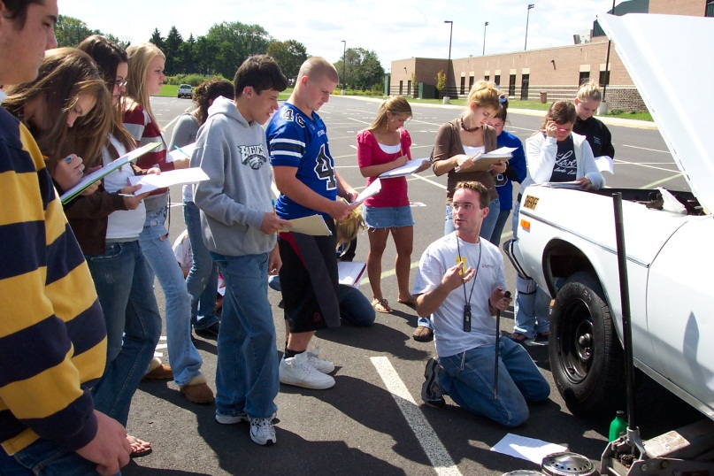

Consumer Issues
Decision making
Living within a budget
Career planning in relation to future goals
Car Maintenance Basics
Making a good purchase
Comparison shopping

Slide 16


Healthy Food Choices
The NEW Food Guide Plate
Nutritional needs
Making healthy food choices
Cooking healthy meals from scratch

Slide 17
Adult Development
Characteristics of Middle and Late Adulthood
Physical Changes
Social and Mental Changes
Roles in each stage of Adult development

Slide 18

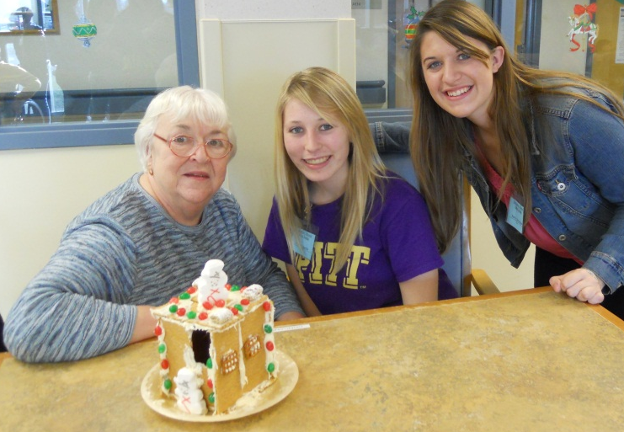
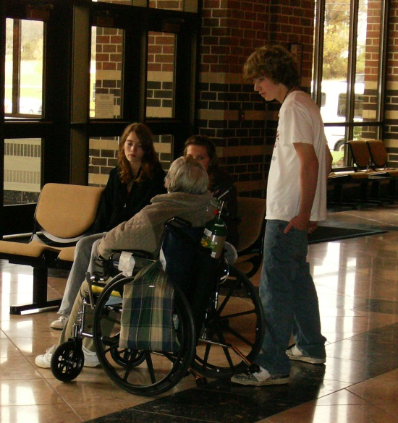
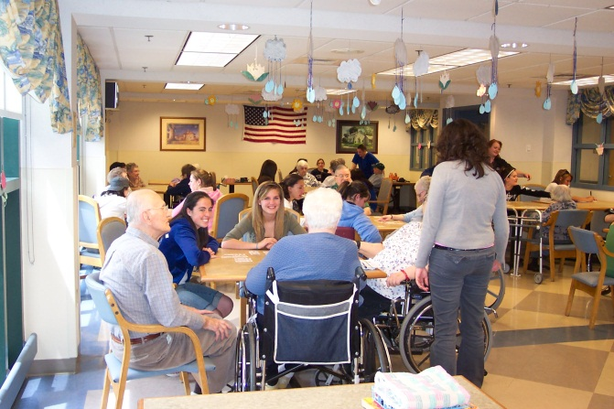
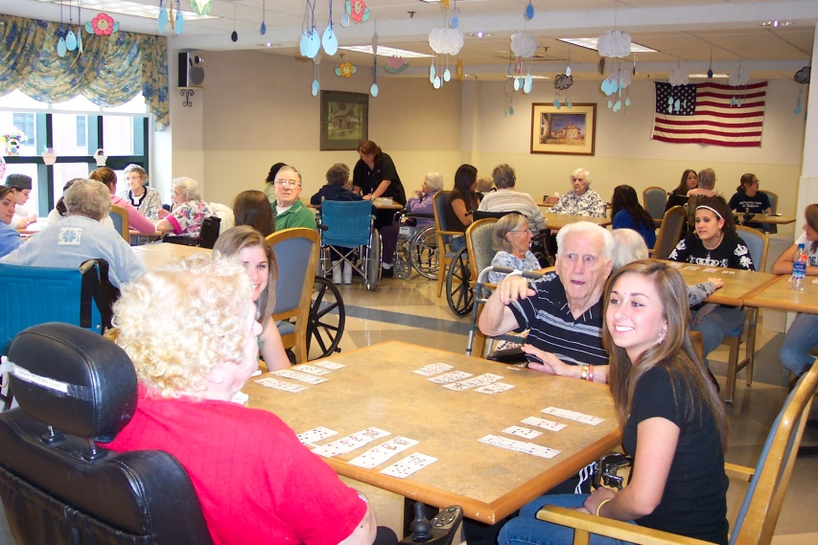
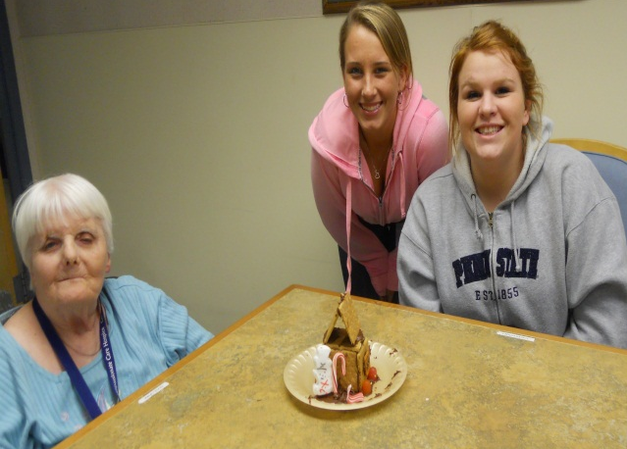
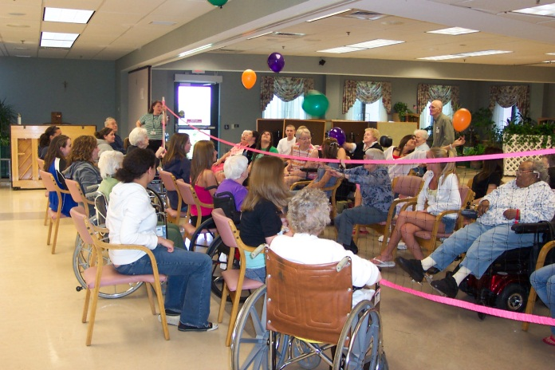
Partnership with a Senior Care Facility
Service learning
Physical and mental characteristics of seniors
Games and activities with seniors
Intergenerational understanding

Slide 19
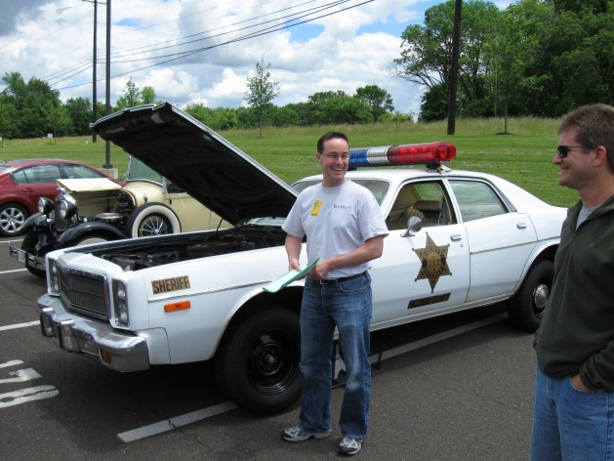
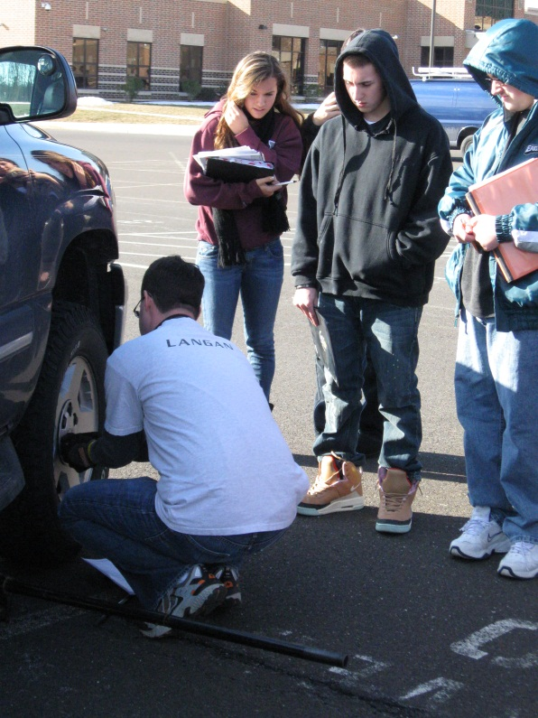
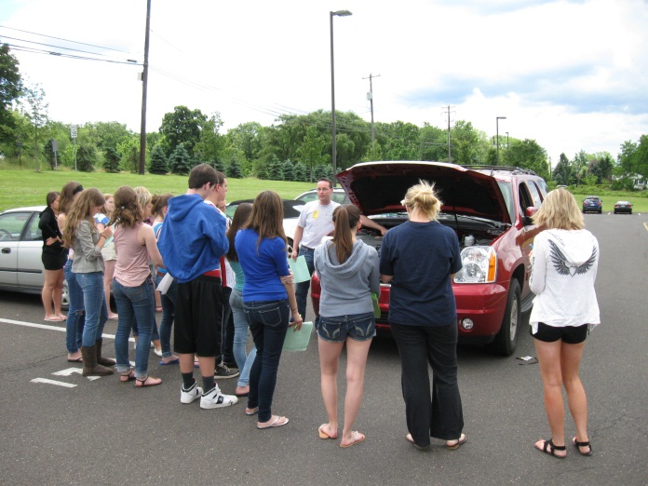
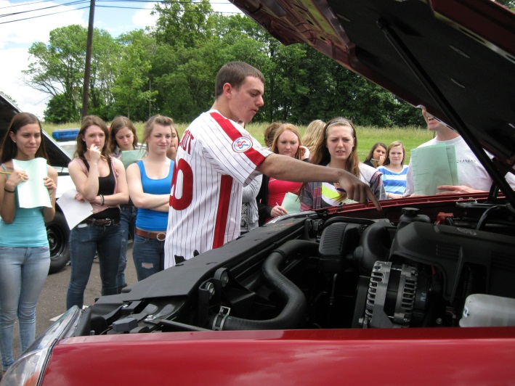
Automotive Care
How to:
Check the fluids
Change a tire
Rotate the tires
Deal with an emergency while driving
Deal with various weather conditions
Keep a car that’s ready for emergencies

Slide 20

Welcome to the game of
LIFE

